Slide 1
Tableau Terminology

Slide 2
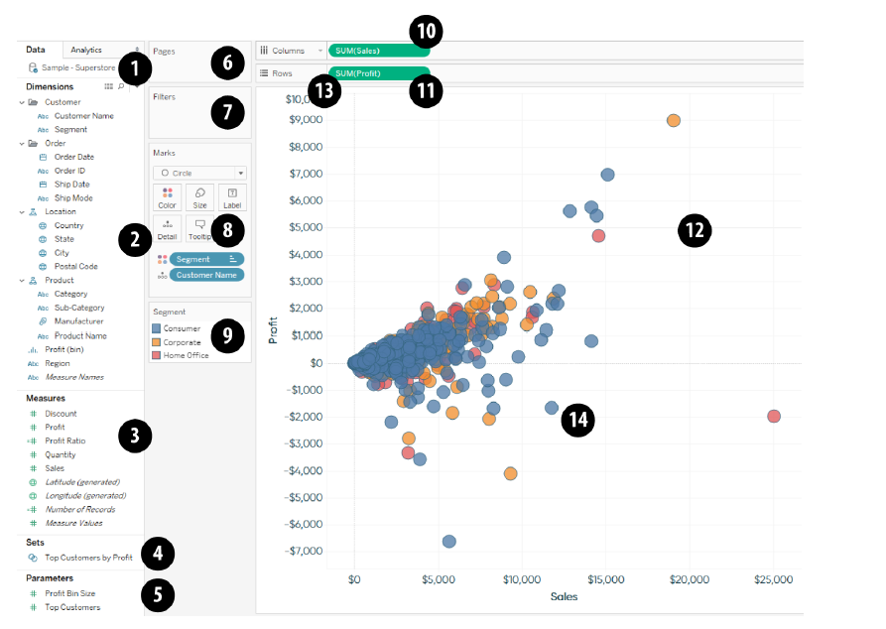

Slide 3
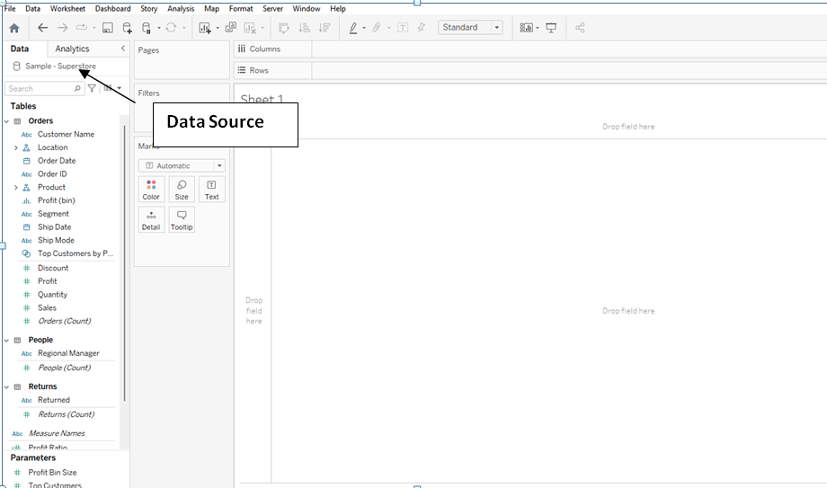
Tableau Terminology
1. Data Sources: Displays all of the data connections in the workbook.
Note that only one data connection (Sample – Superstore) is being displayed in this example, but you can connect to more than one data source at a time.

Slide 4
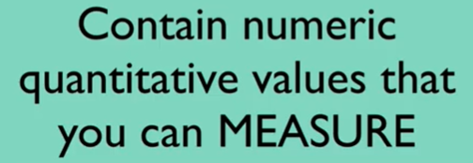
Tableau Terminology
2. Measures area of the Data pane: A list of all the fields in the data source classified as measures
A measure is a field that is a dependent variable; that is, its value is a function of one or more dimensions.
Tableau treats any field containing numeric (quantitative) information as a measure.
A variable from the dataset that is meant to be aggregated. (This means it should be a number that it makes sense to do math with: sum, average, and so on.)
Measures are often continuous data.
Examples include GPA, sales, quantity, quota, height, and salary. When a measure is pulled into your sheet, it takes the form of a green pill.

Slide 5
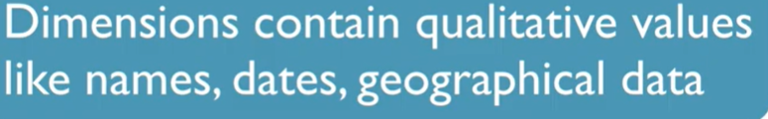
Tableau Terminology
3. Dimensions area of the Data pane: A list of all of the fields in the data source classified as dimensions.
A categorical variable from the dataset that is used to slice and dice the data into different categories.
Dimensions are often discrete data.
Examples include country, gender, student ID, and name. When a dimension is pulled into your sheet, it takes the form of a blue pill.

Slide 6
Tableau Terminology
4. Sets area of the Data pane: If the data source you are using contains at least one set, or if you have created one or more sets, they will show up here.
Sets in Tableau are used to create subsets of data based on certain conditions defined by the user.
For example, a set can be created for having a subset data of top 10 customers with the highest sales.

Slide 7
Tableau Terminology
5. Parameters area of the Data pane: If the workbook you are using contains at least one parameter, or if you have created one or more parameters, they will show up here.

Slide 8
Tableau Terminology
6. Pages Shelf: The Pages Shelf allows you to “flip” through a “page” for each dimension member and/or add animation to a view.
For example, you can put a dimension for Month of Order Date onto the Pages Shelf and have the view rotate through one month of data at a time.

Slide 9
Tableau Terminology
7. Filters Shelf: Any dimension or measure that you filter a view by will be displayed here.
8. Marks Card (Marks Shelf): Each square in this area is called a Marks Card, which are called that because they influence the marks on the view.
Each Marks Card resides on the Marks Shelf. Note that depending on the chart type you are creating, additional cards will show up, such as for Shape or Path.

Slide 10
Tableau Terminology
9. Legend: There are several different legends that will appear here to show how the marks are encoded, including Color (pictured), Size, and Shape.
10. Columns Shelf: Fields placed here will create columns on the view.
11.Rows Shelf: Fields placed here will create rows on the view.

Slide 11
Tableau Terminology
12. Worksheet/View: Each tab in a Tableau workbook is called a worksheet and the area that displays a data visualization is a view.
13.Pill: The slang term for fields being used on a worksheet.
This term is used due to the oblong shape dimensions and measures inherit once they are placed on a shelf or Marks Card.

Slide 12
Tableau Terminology
14. Mark: Each data point on the view.
15. Show Me (not pictured): When you click Show Me in the upper-right corner of the authoring interface, you will see thumbnails for 24 different chart types.

